Slide 1
Why understanding of phase diagrams for alloy systems is extremely important? In most applications of engineered metallic materials, we use alloys rather than pure elements
PHASE DIAGRAMS
Alloy: a material that exhibits properties of a metallic material and is made from multiple elements.
Example : Corrosion-resistant stainless steels are alloys that usually contain iron (Fe), carbon (C), chromium (Cr), nickel (Ni), and some other elements
there is a strong correlation between microstructure and mechanical properties,
the development of microstructure of an alloy is related to the characteristics of its phase diagram
phase diagrams provide valuable information about melting, casting, crystallization, and other phenomena
Notes:
because

Slide 2
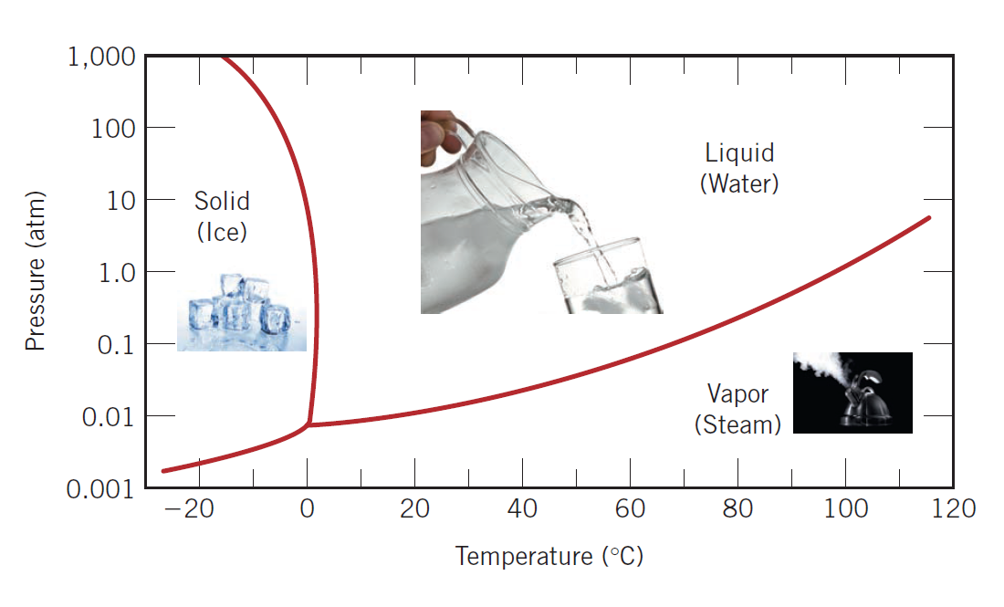
the phase diagram for pure H₂O
A phase : as any portion of a system including the whole which is physically homogeneous within itself and bounded by a surface so that it is mechanically separable from any other portions.
For example, water has three phases—liquid water, solid ice, and steam.
A phase has the following characteristics:
1. the same structure or atomic arrangement throughout;
2. roughly the same composition and properties throughout; and
3. a definite interface between the phase and any surrounding or adjoining phases.

Slide 3
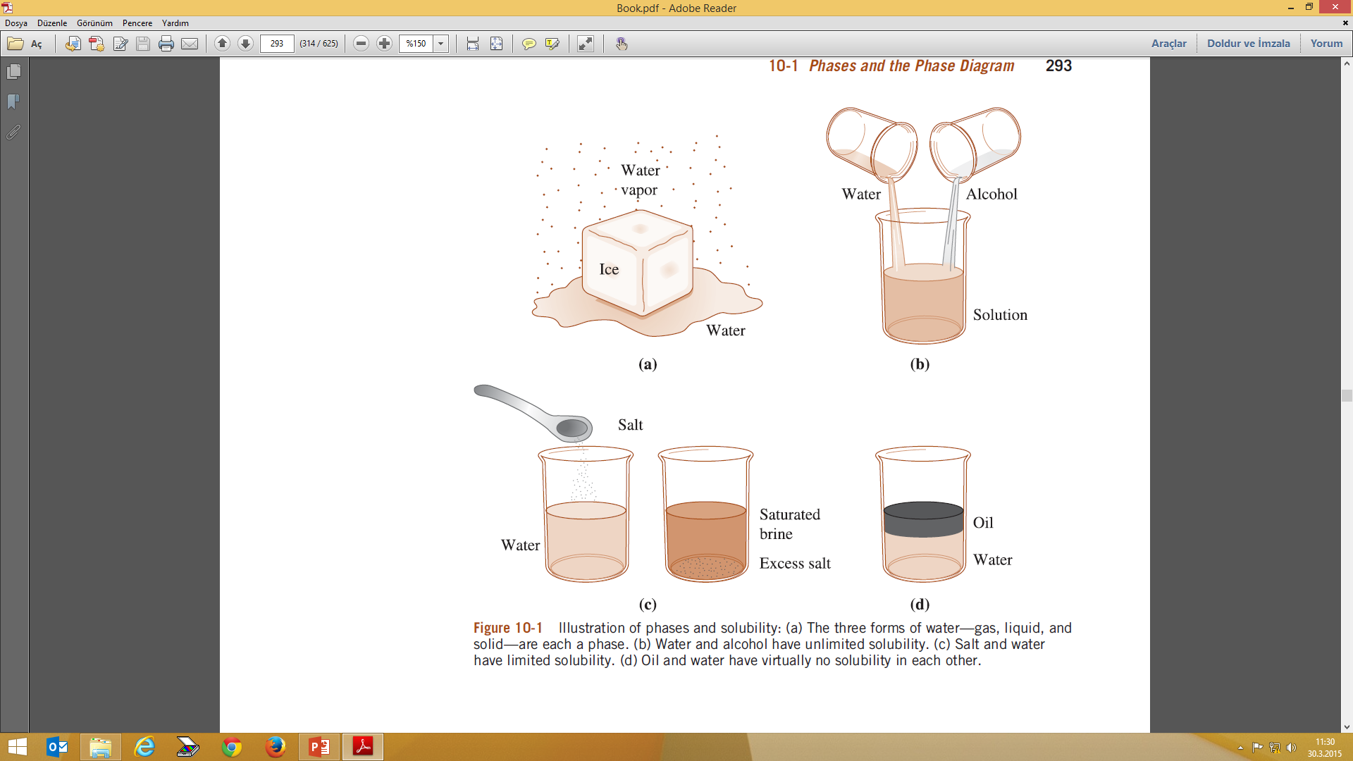

Slide 4
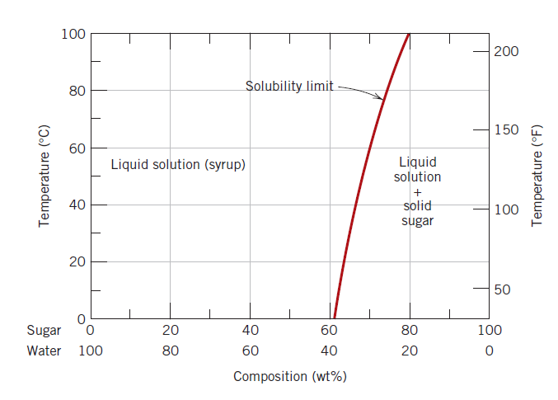
Definitions and Basic Concepts
Solubility Limit: Max concentration for which only a solution occurs. (a maximum concentration of solute atoms that may dissolve in the solvent to form a solid solution)
Solubility limit increases
with T:
e.g., if T = 100°C, solubility limit = 80 wt.% sugar.
Question: What is the solubility limit at 20°C?
Answer: 65 wt.% sugar.
If Composition < 65 wt.% sugar: syrup
If Composition > 65 wt.% sugar: syrup + sugar.

Slide 5
Definitions and Basic Concepts
Phase: A homogeneous portion of a system that has uniform physical and chemical characteristics
Every pure material is considered to be a phase;
e.g. Water; three familiar phases—solid (ice), liquid (water), and vapor (steam)
The sugar–water (mixed)
e.i. syrup solution is one phase, and solid sugar is another.
Each has different physical properties (one is a liquid, the other is a solid);
Each is different chemically (i.e., has a different chemical composition); one is pure sugar, the other is a solution of H₂O and C₁₂H₂₂O₁₁.

Slide 6
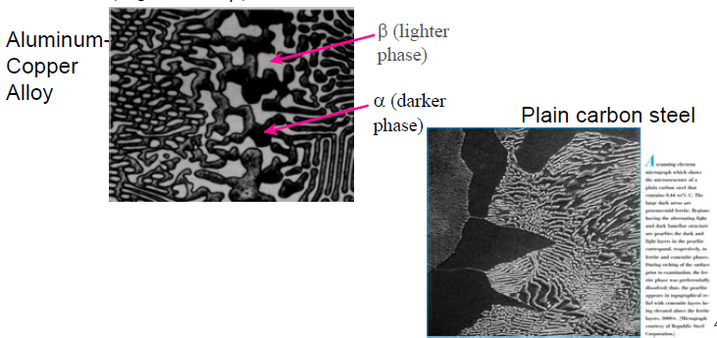
Definitions and Basic Concepts
Components: pure metals and/or compounds of which an alloy is composed
e.i. in a copper–zinc brass, the components are Cu and Zn
(Al and Cu)
the physical properties and, in particular, the mechanical behavior of a material depend on the microstructure
The microstructure of an alloy depends on their concentrations, and the heat treatment of the alloy (i.e., the temperature, the heating time at temperature, and the rate of cooling to room temperature).

Slide 7
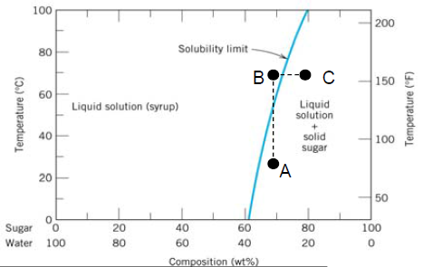
Temperature and composition
A: 2 phases present (liquid solution and solid sugar)
B: Single phase
C: back to 2 phases but at different composition

Slide 8
Phase Equilibrium
Equilibrium: minimum energy state for a given T, P, and composition (i.e. equilibrium state will persist indefinitely for a fixed T, P and composition).
An equilibrium phase will stay constant over time.
Phase diagrams tell us about equilibrium phases as a function of T, P and composition (here, we’ll always keep P constant for simplicity)

Slide 9
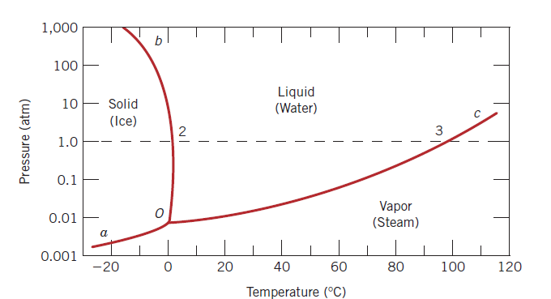
ONE-COMPONENT (OR UNARY) PHASE DIAGRAMS Pressure–temperature (or P–T) diagram
There are three externally controllable parameters that will affect phase structure—temperature, pressure, and composition
One-component system:
the simplest and easiest type of phase diagram to understand
composition is held constant (i.e., the phase diagram is for a pure substance)
pressure and temperature are the variables
Each of the phases will exist under equilibrium conditions over the temperature–pressure ranges of its corresponding area.
the three curves shown on the plot (labeled aO, bO, and cO) are phase boundaries; at any point on one of these curves, the two phases on either side of the curve are in equilibrium (or coexist) with one another.
Pressure–temperature phase diagram for H₂O.

Slide 10
Gibbs phase rule: Describes the relationship between the number of components (C) and the number of phases (P) for a given system and the conditions that may be allowed to change (F) (e.g., temperature, pressure, etc.).
2+C=F+P
C : the number of chemically independent components, usually elements or compounds
F : the number of degrees of freedom, or the number of variables (such as temperature, pressure, or composition), that are allowed to change independently without changing the number of phases in equilibrium
P: the number of phases present
Note that phases do not always have to be solid, liquid, and gaseous forms of a material. An element, such as iron (Fe), can exist in FCC and BCC crystal structures. These two solid forms of iron are two different phases of iron that will be stable at different temperatures and pressure conditions.

Slide 11
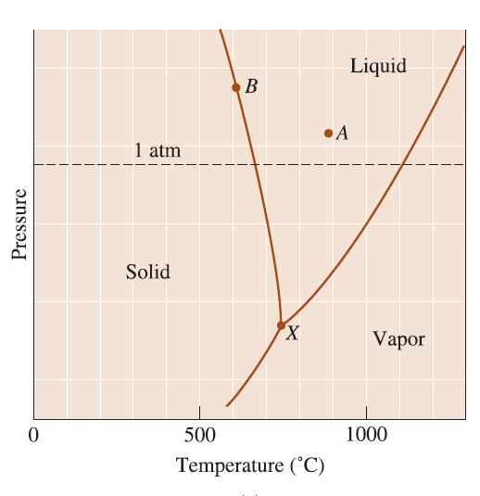
Example of Gibbs phase rule
unary (C = 1) phase diagram of magnesium
Unary phase diagram is also called a pressure temperature or P-T diagram
A point = all magnesium is liquid. The number of phases is one (liquid). The phase rule tells us that there are two degrees of freedom
2+C = F+P; therefore; 2 +1 = F+ 1 (i.e., F =2)
we can change the pressure, the temperature, or both, and still be in an all-liquid portion of the diagram. Put another way, we must fix both the temperature and the pressure to know precisely where we are in the liquid portion of the diagram.
B point : the boundary between the solid and liquid portions of the diagram.
X point : solid, liquid, and vapor coexist
2+C = F+P; therefore; 2 +1 = F+ 3
(i.e., F =0)
no degrees of freedom; all three phases coexist only if both the temperature
and the pressure are fixed.
2+C = F+P; therefore; 2 +1 = F+ 2 (i.e., F =1)
one degree of freedom. For example, if we change the temperature, the pressure must also be adjusted.

Slide 12
BINARY PHASE DIAGRAMS
Extremely common phase diagram
Temperature and composition are variable parameters,
Pressure is held constant—normally 1 atm
Contain two components
Binary phase diagrams are maps that represent the relationships between temperature and the compositions and quantities of phases at equilibrium, which influence the microstructure of an alloy.

Slide 13
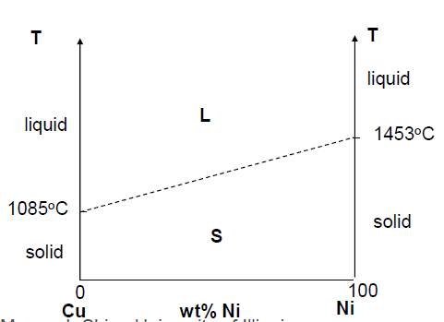
BINARY PHASE DIAGRAMS
BINARY ISOMORPHOUS SYSTEMS
Complete liquid and solid solubility
2 components
For a pure component,
complete melting occurs before T increases (sharp phase transition).But for multicomponent systems, there is usually a coexistence of L
and S.

Slide 14
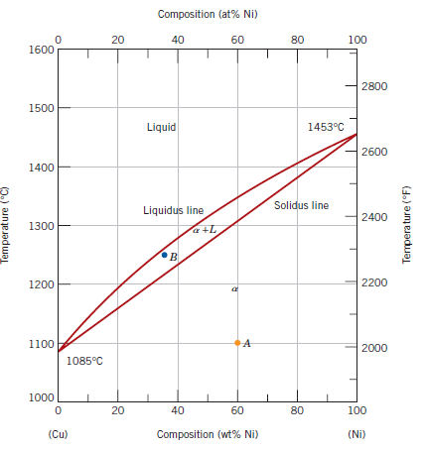
BINARY PHASE DIAGRAMS
BINARY ISOMORPHOUS SYSTEMS
This complete solubility is explained:
-both Cu and Ni have the same crystal structure (FCC),
-nearly identical atomic radii and electronegativities,
-similar valences
Nomenclature:
solid solutions are designated by lowercase Greek letters (α, β, γ, etc.).
phase boundaries:
- the line separating the L and α+L phase fields is termed the liquidus line. The liquid phase is present at all temperatures and compositions above this line.
- The solidus line is located between the α and L+α regions, below which only the solid phase exists.
Solid-liquid coexistence region

Slide 15
BINARY PHASE DIAGRAMS
BINARY ISOMORPHOUS SYSTEMS
What can we learn from this phase diagram?
1. Phase(s) present.
A: solid (α) only
B: solid and liquid
2. Composition of those phases
A: 60 wt% Ni
B: 35 wt% Ni overall
3. The liquid L is a homogeneous liquid solution composed of both copper and nickel. The α phase is a substitutional solid solution consisting of both Cu and Ni atoms, and having an FCC crystal structure
4.Amount of the phases.
A: 100% α phase (60 wt% Ni–40 wt% Cu alloy at 1100C)
B: % solid (α) and % liquid (L)
(35 wt.% Ni - 65 wt.% Cu)
This complete solubility is explained by the fact that both Cu and Ni have the same crystal structure (FCC), nearly identical atomic radii and electronegativities, and similar valences
Solid-liquid coexistence region

Slide 16
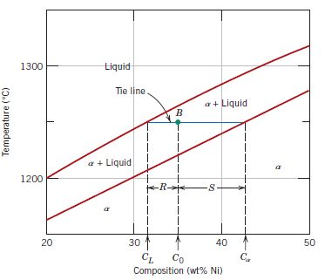
BINARY PHASE DIAGRAMS
BINARY ISOMORPHOUS SYSTEMS
Determining phase composition in 2-phase region:
For an alloy having composition and temperature located in a two-phase region,
the situation is more complicated
1. Draw the tie line.
2. Note where the tie line intersects the liquidus and solidus lines (i.e. where the tie line crosses the phase boundaries).
3. Read off the composition at the
boundaries:
Liquid is composed of C_{L}
amount of Ni
(31. 5 wt.% Ni and 68.5 wt.% Cu)
Solid is composed of Cα
amount of Ni
(42.5 wt.% Ni and 57.5 wt.%).

Slide 17
BINARY PHASE DIAGRAMS
BINARY ISOMORPHOUS SYSTEMS
Determination of Phase Amounts
in the single-phase region: because only one phase is present, the alloy is composed entirely of that phase; that is, the phase fraction is 1.0 or, alternatively, the percentage is 100%.
Example : @ point A : 60 wt% Ni–40 wt% Cu alloy at 1100C, only the α phase is present; hence, the alloy is completely or 100% .

Slide 18
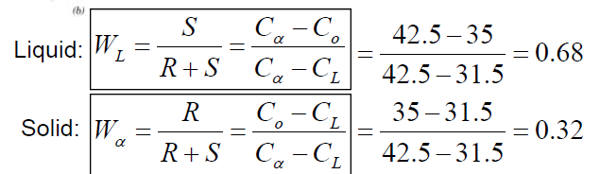
BINARY PHASE DIAGRAMS
BINARY ISOMORPHOUS SYSTEMS
Determination of Phase Amounts
within a two-phase region
(Lever Rule)
Draw the tie line for a given temperature.
2. Determine the distance from the
point of interest (B) to each of the
phase boundaries.
R = C_{o} – C_{L}
S = C_{α} - C_{o}
3. Mass fractions (wt%) of each
phase:
i.e. 68% of the mass is liquid and 32% of the mass is soli
Notes:
.

Slide 19
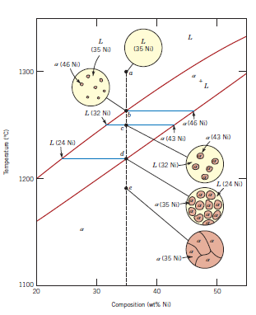
BINARY PHASE DIAGRAMS
Microstructures in Isomorphous Alloys
Microstructures will vary on the cooling rate (i.e. processing conditions)
1. Equilibrium Cooling: Very slow cooling to allow phase equilibrium to be maintained during the cooling process.
a (T>1260°C): start as homogeneous liquid solution.
b (T ~ 1260°C): liquidus line reached. α phase begins to nucleate.
C_{α} = 46 wt.% Ni and 54 wt.% Cu
C_{L} = 35 wt.% Ni and 65 wt.% Cu
c (T= 1250°C): calculate composition
and mass fraction of each phase.
d (T~ 1220°C): solidus line reached.
Nearly complete solidification.
C_{α} = 35 wt% Ni; C_{L} = 24 wt% Ni
e (T<1220°C): homogeneous solid
solution with 35 wt% Ni.

Slide 20
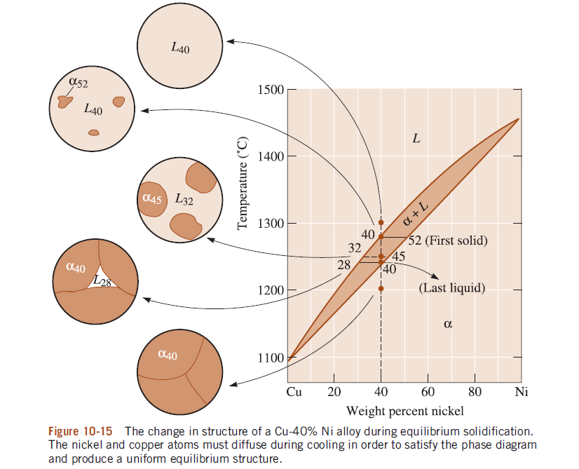

Slide 21
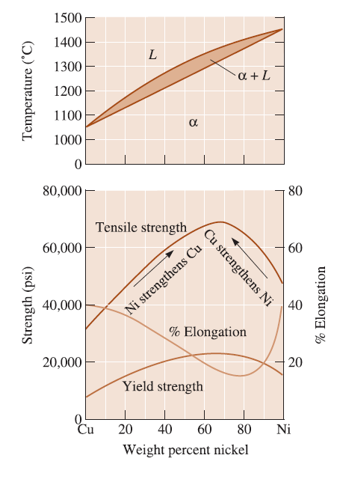
Relationship Between Properties and the Phase Diagram

Slide 22
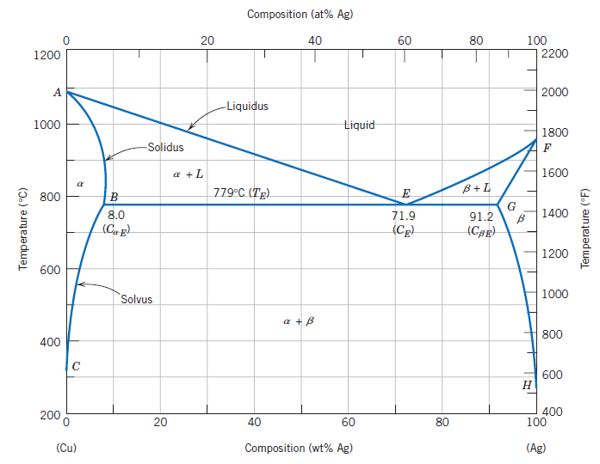
BINARY EUTECTIC SYSTEMS
“easily melted”
Single phase regions:
α-phase (solid solution rich in Cu).
β-phase (solid solution rich in Ag).
L-phase (liquid solution).
2-Phase coexistence regions:
α+β phases (limited solubility of Ag
in Cu and vice versa lead to 2
different solid solution phases).
α+L and β+L phase regions.
Tie lines and Lever Rule can be
applied in the 2-phase regions.
The copper–silver phase diagram

Slide 23
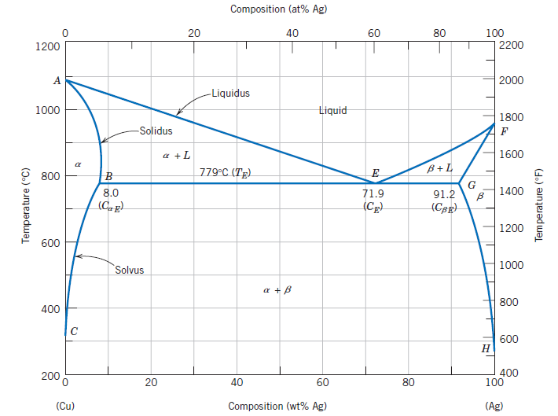


BINARY EUTECTIC SYSTEMS
Eutectic point: Where 2 liquidus lines meet (pt. E).
Sometimes also referred to as invariant point.
Eutectic Reaction:
C_{E} = eutectic composition
T_{E}= eutectic temperature
C_{αE} = compositions of the α
C_{βE}= compositions of the β
the copper–silver system, the eutectic reaction

Slide 24
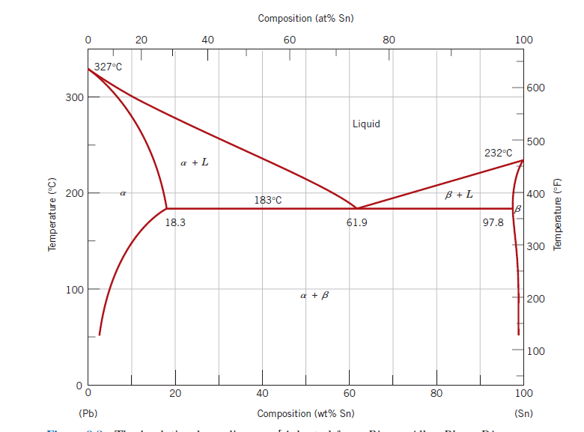
Example: Determination of Phases Present and Computation of Phase Compositions & Mass and Volume Fractions
For a 40 wt% Sn–60 wt% Pb alloy at 150°C,
(a) what phase(s) is (are) present?
(b) What is (are) the composition(s) of the phase(s)?
(c) calculate the mass fraction of relative amount of each phase present
(d) calculate the volume fraction of relative amount of each phase present

Slide 25
Example: Determination of Phases Present and Computation of Phase Compositions & Mass and Volume Fractions
Solution:
For a 40 wt% Sn–60 wt% Pb alloy at 150°C,
(a) what phase(s) is (are) present?
both α and β phases
will coexist

Slide 26
Example: Determination of Phases Present and Computation of Phase Compositions & Mass and Volume Fractions
Solution:
For a 40 wt% Sn–60 wt% Pb alloy at 150°C,
(b) What is (are) the composition(s) of the phase(s)?
C_{α} =11 wt% Sn–89 wt% Pb
C_{β} =98 wt% Sn–2 wt% Pb
C_{α}
C_{β}

Slide 27
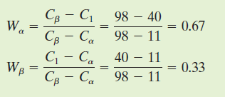
Example: Determination of Phases Present and Computation of Phase Compositions & Mass and Volume Fractions
Solution:
For a 40 wt% Sn–60 wt% Pb alloy at 150°C,
(c) calculate the mass fraction of relative amount of each phase present
Because the alloy consists of two phases, it is necessary to employ the lever rule.
C_{α}
C₁
C_{β}

Slide 28
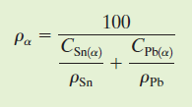
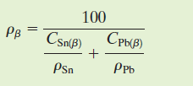


Example: Determination of Phases Present and Computation of Phase Compositions & Mass and Volume Fractions
Solution:
For a 40 wt% Sn–60 wt% Pb alloy at 150°C,
(c) calculate the volume fraction of relative amount of each phase present
the densities of Pb and Sn to be 11.23 and 7.24 g/cm³, respectively
To compute volume fractions it is first necessary to determine the density of each phase
C_{α} =11 wt% Sn–89 wt% Pb
C_{β} =98 wt% Sn–2 wt% Pb

Slide 29
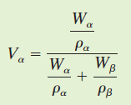
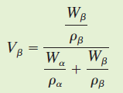
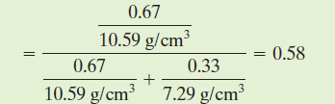
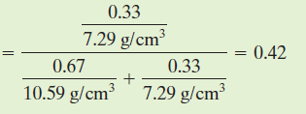
Example: Determination of Phases Present and Computation of Phase Compositions & Mass and Volume Fractions
Solution:
To compute volume fractions it is first necessary to determine the density of each phase
C_{α} =11 wt% Sn–89 wt% Pb
C_{β} =98 wt% Sn–2 wt% Pb

Slide 30
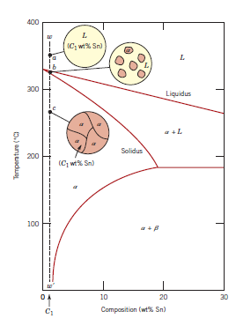
Microstructures in Eutectic Alloys
1. One component rich composition.
a: start with homogeneous liquid.
b: α-phase solids with liquid.
Compositions and mass fractions can be
found via tie lines and lever rule.
c: α-phase solid solution only.
Net result: polycrystalline α solid.
Cooling at this composition is similar to
binary isomorphous systems.
Partial Pb-Sn phase diagram

Slide 31
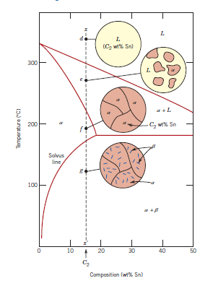
Microstructures in Eutectic Alloys
2. One-component rich but cooling to α + β
coexistence.
d: homogeneous liquid.
e: α + L phase (same as previous but at
different compositions and mass fractions).
f: all α-phase solid solution.
g: α + β phase (passing through solvus line
leads to exceeding solubility limit and β phase
precipitates out).
Net result: polycrystalline α-solid with fine β
crystals
Partial Pb-Sn phase diagram

Slide 32
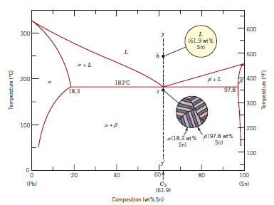

Microstructures in Eutectic Alloys
Eutectic Structure: layered (lamellar)
structure
3. Cooling through eutectic point.
h: homogeneous liquid.
i: solidification via eutectic reaction
note: α and β phases have very
different compositions than the
original composition of the liquid (e.g.
C_{α} = 18.3 wt% Sn; C_{β} = 97.8 wt% Sn
whereas C_{L} = 61.9 wt% Sn).

Slide 33
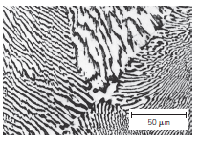
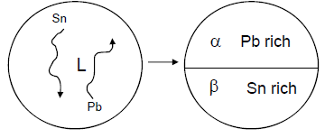
Microstructures in Eutectic Alloys
Photomicrograph showing the microstructure of a lead–tin alloy of eutectic composition. This microstructure consists of alternating layers of a lead rich -phase solid solution (dark layers),
and a tin-rich -phase solid solution (lightlayers). 375X.
Lamellar structure forms because relatively short
diffusion lengths are required
In order to achieve large homogeneous regions, long diffusion lengths are required

Slide 34
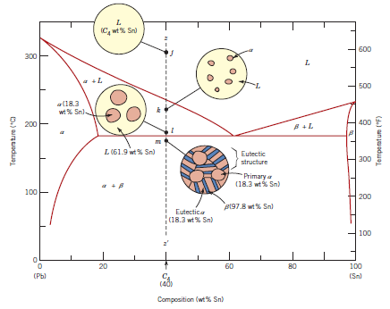
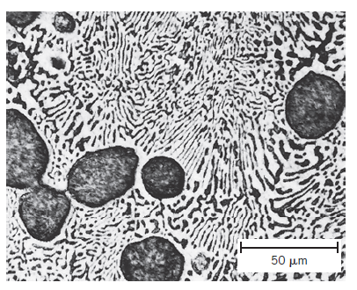
Microstructures in Eutectic Alloys
4. Cooling through eutectic
isotherm.
j: homogeneous liquid.
Hypoeutectic
k: α + L phases: use tie lines and lever rule.
l: just above eutectic isotherm compositions given
m: remaining liquid transforms to eutectic structure upon crossing eutectic isotherm.
Microconstituent: an element of a microstructure with identifiable and characteristic structure (at pt. m there are 2 microconstituents: primary α
and eutectic structures)
Photomicrograph showing the microstructure of a lead–tin alloy of composition 50 wt% Sn–50 wt% Pb. This microstructure is
composed of a primary lead-rich phase (large dark regions) within a
lamellar eutectic structure consisting of a tin-rich phase (light layers) and a lead-rich phase (dark layers).400 X.

Slide 35
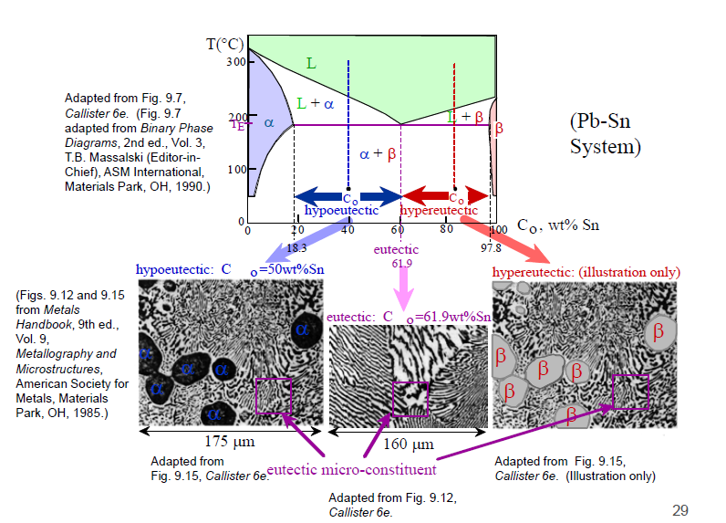
Microstructures in Eutectic Alloys

Slide 36
EQUILIBRIUM DIAGRAMS HAVING INTERMEDIATE PHASES OR COMPOUNDS

Slide 37
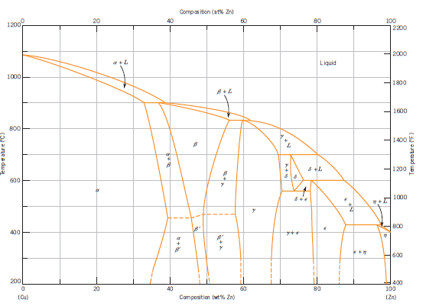
there are six different solid solutions—two terminal ( α and η) and four intermediate ( β, γ, δ and ε).
β‘phase is termed an ordered solid solution, one in which the copper and zinc atoms are situated in a specific and ordered arrangement within each unit cell
dashed to indicate that their positions have not been exactly determined

Slide 38
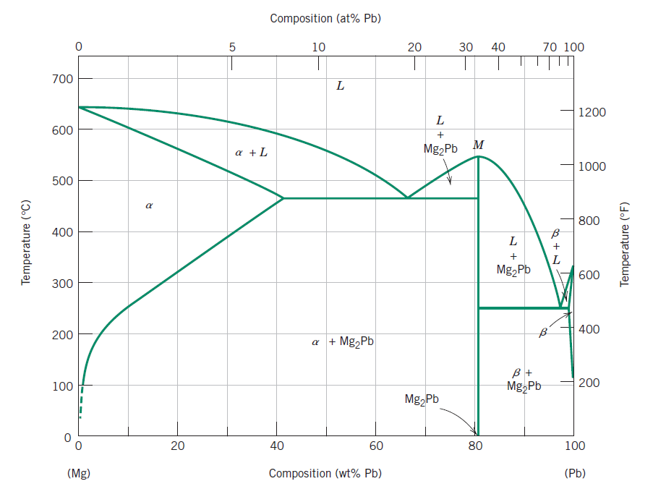
Intermediate (intermetallic) compounds: discrete metal compounds (Mg₂Pb) rather than solutions (i.e. distinct chemical formula).
A_{x}B_{y}: in solution x and y can vary
in compounds x and y are fixed (always fixed composition of A and B).
i.e. Mg₂Pb: 19 wt% Mg–81 wt% Pb
the compound Mg₂Pb melts at approximately 550°C, as indicated by point M
the solubility of lead in magnesium is rather extensive, the relatively large composition span for the α-phase field.
the solubility of magnesium in lead is extremely limited (β region)

Slide 39
EUTECTOID AND PERITECTIC REACTIONS

Slide 40
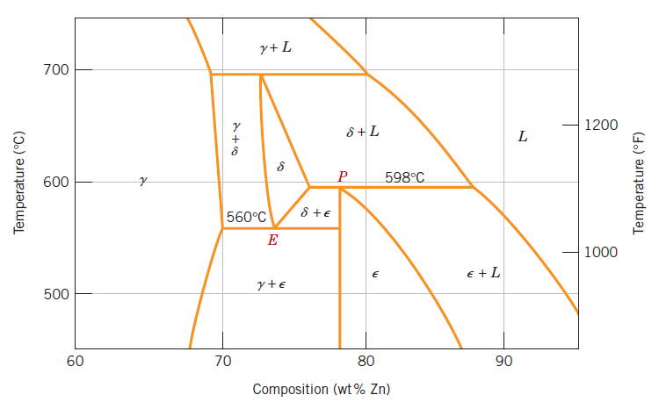


Eutectoid reaction: one solid phase turning into two other solid phases upon cooling
Peritectic reaction: one solid phase transforms into liquid and a different solid phases upon heating
Notes:
In addition to the eutectic, other invariant points involving three different phases
are found for some alloy systems. One of these occurs for the copper–zinc system

Slide 41
Gibbs Phase Rule
The construction of phase diagrams as well as some of the principles governing the conditions for phase equilibria are dictated by laws of thermodynamics.
Gibbs Phase rule: represents a criterion for the number of phases that will coexist within a system at equilibrium,
P+F = C+N
P: the number of phases present
F: the number of degrees of freedom or the number of externally controlled variables (e.g., temperature, pressure, composition) (F is the number of these variables that can be changed independently without altering the number of phases that coexist at equilibrium)
C: the number of components in the system, in the case of phase diagrams, are the
materials at the two extremities of the horizontal compositional axis (e.g., H2O and
C12H22O11 -sugar, or Cu and Ni
N: the number of noncompositional variables (e.g., temperature and pressure)

Slide 42
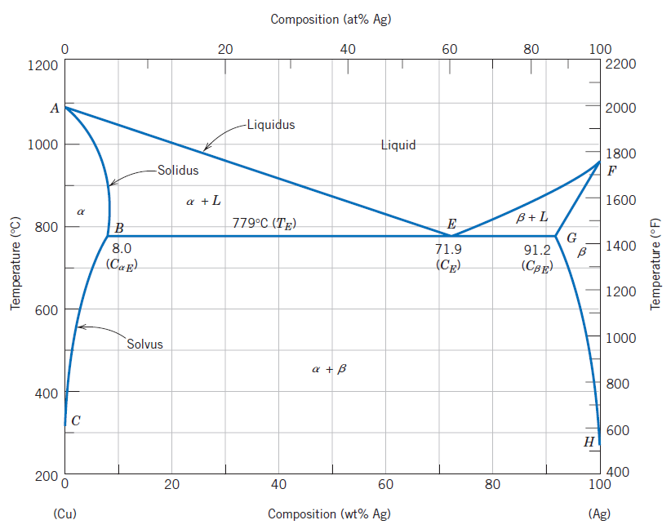
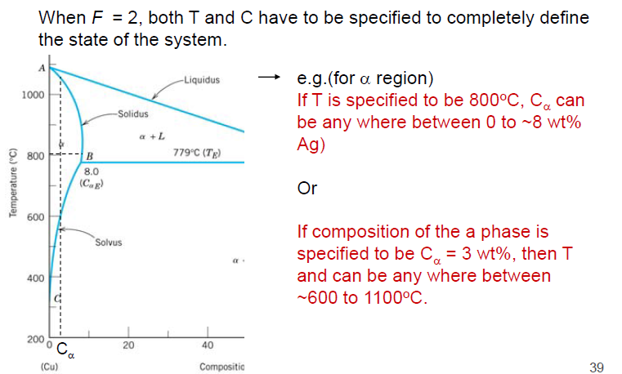
Gibbs Phase Rule
Because pressure is constant (1 atm), the parameter N is 1—temperature is the only noncompositional variable.
the number of components C is 2 (Cu and Ag),
P + F =2 +1= 3
F = 3 –P
Consider the case of single-phase fields on the phase diagram (e.g.α,β,and liquid regions). Because only one phase is present, P = 1 and
F=3-1=2
This means :any alloy that exists within one of these phase fields (α,β,and liquid regions) , we must specify two parameters; these are composition and temperature, which locate, respectively, the horizontal and vertical positions of the alloy on the phase diagram

Slide 43
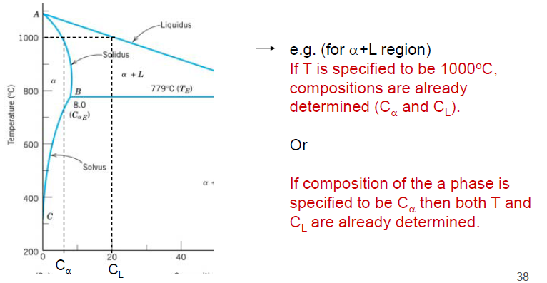
Gibbs Phase Rule
Because pressure is constant (1 atm), the parameter N is 1—temperature is the only noncompositional variable.
the number of components C is 2 (Cu and Ag),
P + F =2 +1= 3
F = 3 –P
For the situation wherein two phases coexist, for example, α+ L, β+ L, and α+β phase regions,
F=3-2=1
Thus, it is necessary to specify either temperature or the composition of one of the
phases to completely define the system. For example, suppose that we decide to
specify temperature for the α+ L phase region, say, T1.

Slide 44
THE IRON–IRON CARBIDE (Fe–Fe₃C) PHASE DIAGRAM

Slide 45
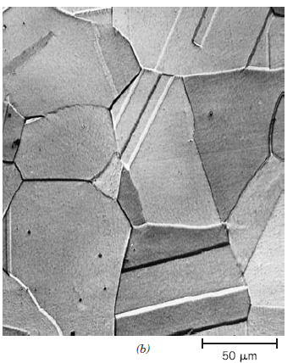
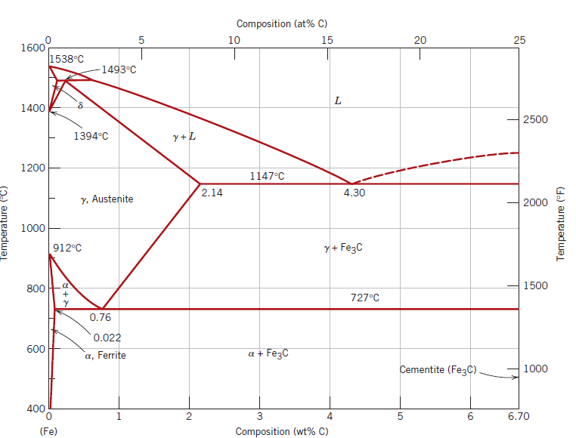
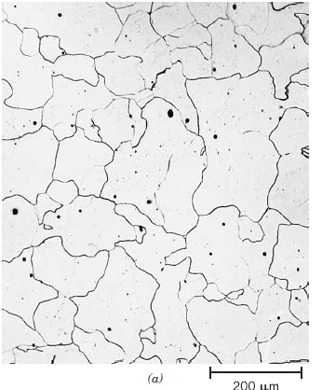



Photomicrographs of (a) α-ferrite (90)
and (b) γ-austenite (325).
Carbon is an interstitial impurity in iron
Peritectic
$$γ$$
STEEL
0.008-2.14
wt% C
in practice, carbon concentrations rarely exceed
1.0 wt%.
Eutectic point
CAST IRONS
(2.14 and 6.70 wt% C). commercial cast irons normally contain less than 4.5 wt% C.
Eutectoid
Commercially pure iron contains less than 0.008 wt% C
In practice, all steels and cast irons have carbon contents less than 6.70 wt% C
the intermediate compound iron carbide,cementite (Fe₃C)

